Slide 1
Restricted Boltzmann machines

Slide 2
Boltzmann Machine was first invented in 1985 by Geoffrey Hinton, a professor at the University of Toronto. He is a leading figure in the deep learning community and is referred to by some as the “Godfather of Deep Learning”.
Boltzmann Machine is a generative unsupervised model, which involves learning a probability distribution from an original dataset and using it to make inferences about never-before-seen data.
Boltzmann Machine has an input layer (also referred to as the visible layer) and one or several hidden layers (also referred to as the hidden layer).

Slide 3
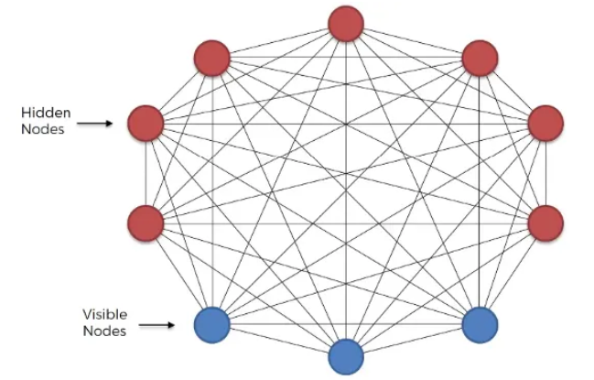

Slide 4
Boltzmann Machine uses neural networks with neurons that are connected not only to other neurons in other layers but also to neurons within the same layer.
Boltzmann Machine consists of a neural network with an input layer and one or several hidden layers. The neurons in the neural network make stochastic decisions about whether to turn on or off based on the data we feed during training and the cost function the Boltzmann Machine is trying to minimize.
By doing so, the Boltzmann Machine discovers interesting features about the data, which help model the complex underlying relationships and patterns present in the data.
Training an unrestricted Boltzmann machine was very inefficient and Boltzmann Machine had very little commercial success.

Slide 5
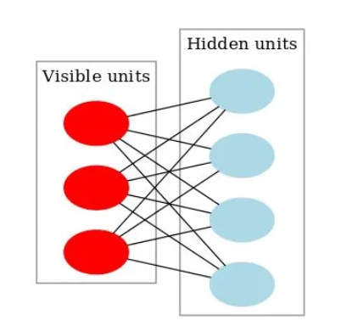
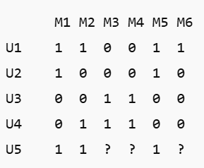
Restricted Boltzmann Machine.
The goal of a Restricted Boltzmann Machine (RBM) is to learn a probability distribution over the input data - that is, to model the underlying structure and dependencies between the visible variables (the input features).
Movies: M1…M6 (Inception, Interstellar, The Notebook, Titanic, The Avengers, Iron Man) Users’ like/dislike matrix:

Slide 6
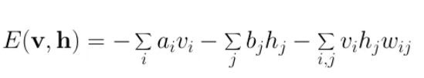
Energy-Based Model.
Energy is a term that may not be associated with deep learning in the first place. Rather is energy a quantitative property of physics. E.g. gravitational energy describes the potential energy a body with mass has in relation to another massive objected due to gravity. Yet some deep learning architectures use the idea of energy as a metric for the measurement of the model’s quality.
One purpose of deep learning models is to encode dependencies between variables. The capturing of dependencies happens through associating of scalar energy to each configuration of the variables, which serves as a measure of compatibility. High energy means bad compatibility.
An energy-based model always tries to minimize a predefined energy function. The energy function for the RBMs is defined as:
When left undisturbed, an electron naturally tends to stay or return to its lowest-energy (most stable) state

Slide 7
As can be noticed the value of the energy function depends on the configurations of visible/input states, hidden states, weights, and biases. The training of RBM consists of the finding of parameters for given input values so that the energy reaches a minimum.
Restricted Boltzmann Machine.
What makes RBMs different from Boltzmann machines is that visible node isn’t connected to each other, and hidden nodes aren’t connected with each other. Other than that, RBMs are exactly the same as Boltzmann machines.
RBM is the neural network that belongs to the energy-based model.
It is a probabilistic, unsupervised, generative model.
RBM is undirected and has only two layers, Input layer, and hidden layer.
· All visible nodes are connected to all the hidden nodes. RBM has two layers, visible layer or input layer and hidden layer so it is also called an asymmetrical bipartite graph.

Slide 8

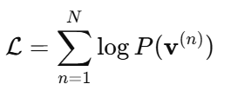
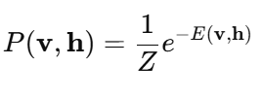

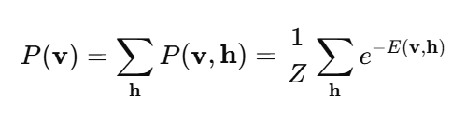
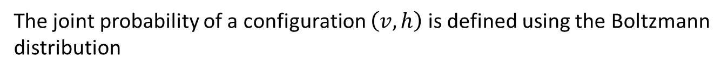
RBM’s objective is to find the joint probability distribution that maximizes the log-likelihood function.
The joint probability of a configuration $\left(v,h\right)$is defined using the Boltzmann distribution
Maximizing the log-likelihood function, makes the model assign higher probability to configurations similar to training data.
Making the model distribution as close as possible to the true data distribution.

Slide 9
The learning process
Since RBMs are undirected, they don’t adjust their weights through gradient descent and backpropagation. They adjust their weights through a process called contrastive divergence.
At the start of this process, weights for the visible nodes are randomly generated and used to generate the hidden nodes.
These hidden nodes then use the same weights to reconstruct visible nodes.
The weights used to reconstruct the visible nodes are the same throughout. However, the generated nodes are not the same because they aren’t connected to each other.

Slide 10
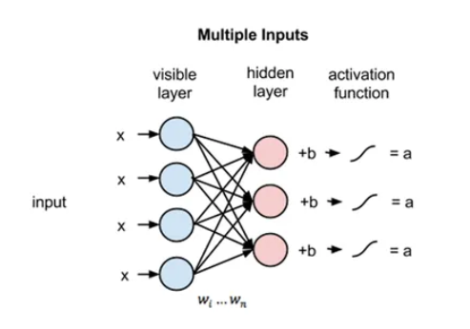


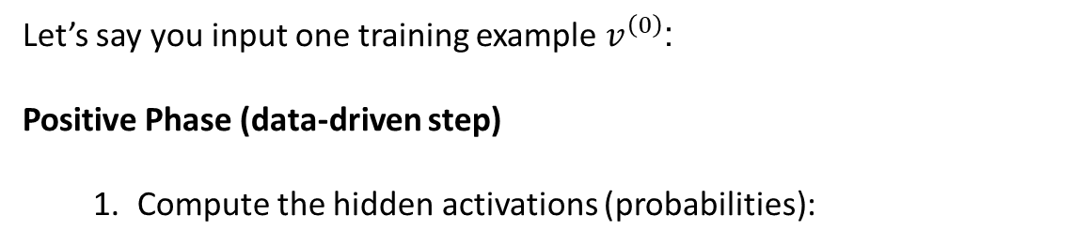

The learning process
Let’s say you input one training example $v^{\left(0\right)}$:
Positive Phase (data-driven step)
Compute the hidden activations (probabilities):
2. Sample hidden states $h^{\left(0\right)}$from this probability
3. Compute the association between visible and hidden:
This shows how often a visible unit and a hidden unit are active together in real data.

Slide 11
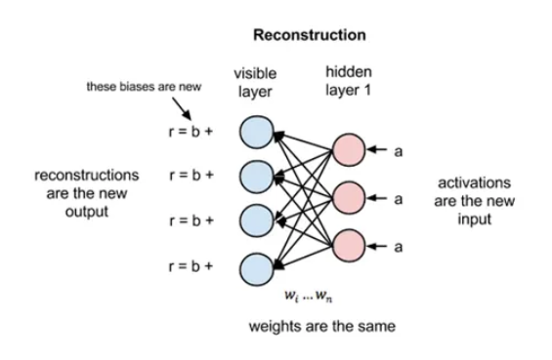




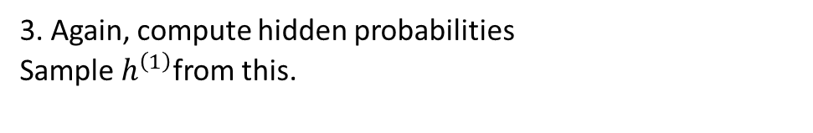

Negative Phase (model reconstruction step)
1. Using $h^{\left(0\right)}$, reconstruct visible units:
2. Sample $v^{\left(1\right)} :$reconstructed data.
3. Again, compute hidden probabilities Sample $h^{\left(1\right)}$from this.
4. Compute model association

Slide 12
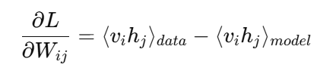

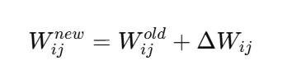

Weight update

Slide 13


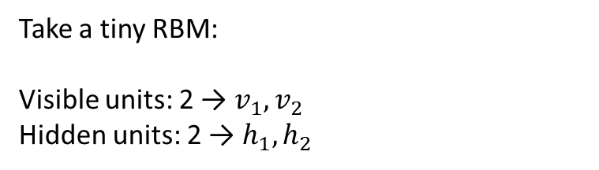

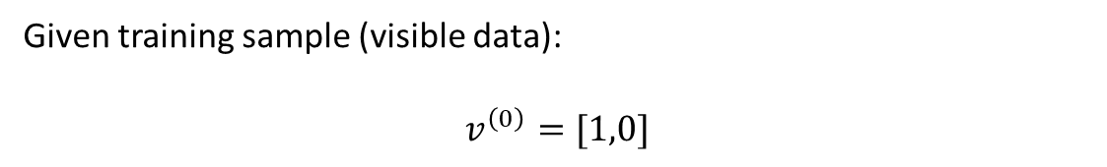
Take a tiny RBM:
Visible units: 2 → $v_{1},v_{2}$
Hidden units: 2 → $h_{1},h_{2}$
$b=\left[0.1 , −0.2\right] ($hidden biases)
a = [0,0] (visible biases)
Given training sample (visible data):
$$v^{\left(0\right)}=[1,0]$$
Compute hidden activation probabilities
For each hidden node $h_{j}$

Slide 14
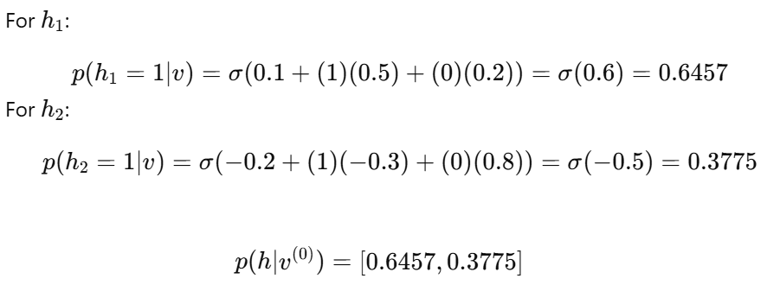
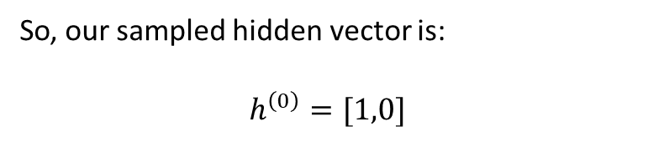
Sample hidden states
Hidden unit | Probability | Sample (h=1?)
$$h_{1}$$ | 0.6457 | → 1 (activated)
$$h_{2}$$ | 0.3775 | → 0 (not activated)
So, our sampled hidden vector is:
$$h^{\left(0\right)}=[1,0]$$

Slide 15

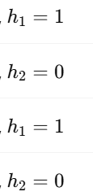
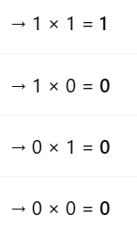
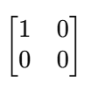
Compute associations ⟨v_i h_j⟩_{data}
association matrix ⟨v h⟩_{data} is:
The visible unit $v_{1}$and hidden unit $h_{1}$are active together, meaning the model sees a strong connection between them.

Slide 16

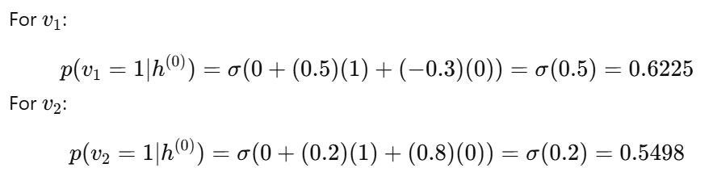


We, now use the sampled hidden vector $h^{\left(0\right)}=[1,0]$
We compute probabilities for each visible unit
Since $h_{1}=1$and $h_{2}=0$:
So, the reconstructed visible probabilities are:

Slide 17
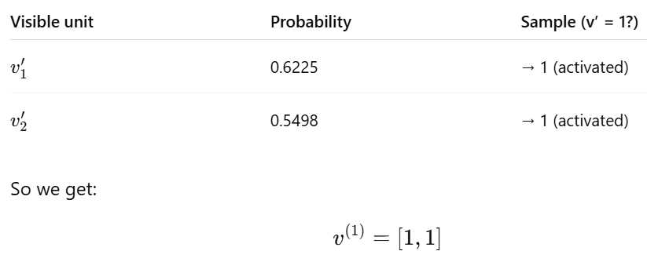
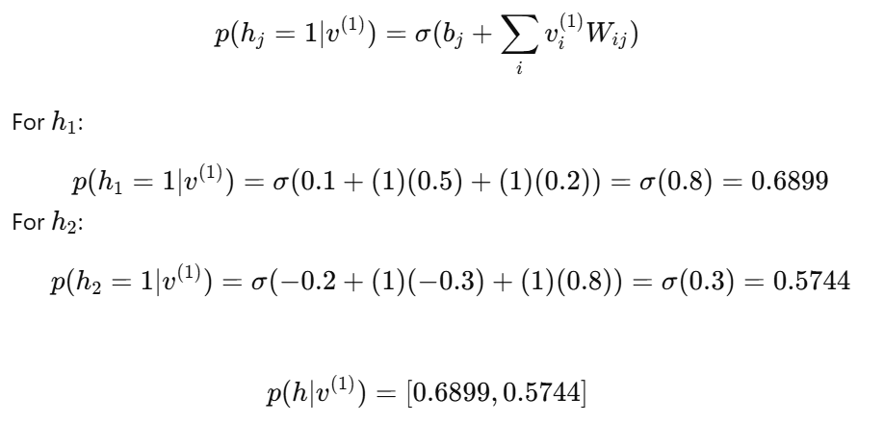
Sample reconstructed visible units
Recompute hidden probabilities for reconstructed visible

Slide 18
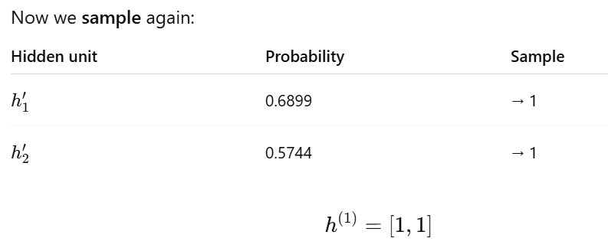
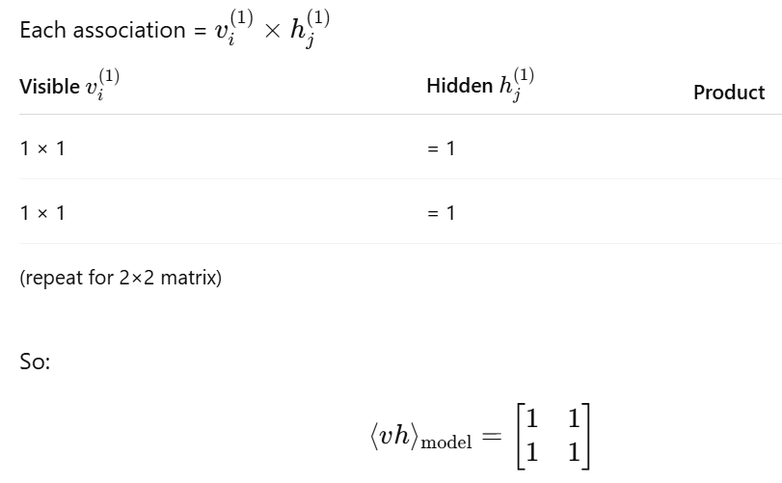
Compute model associations ⟨v h⟩_{model}

Slide 19
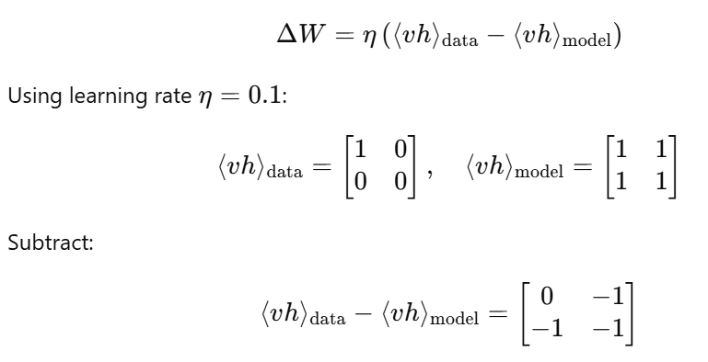
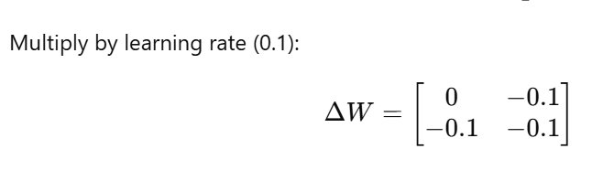
Update weights (learning)

